Slide 1
Responsible AI

Slide 2
What is Responsible AI?
It is the practice of developing and using AI systems in a way that benefits society while minimizing the risk of negative consequences.
It’s about creating AI technologies that not only advance our capabilities, but also address ethical concerns – particularly regarding bias, transparency and privacy.
Responsible AI is an approach to developing and deploying artificial intelligence from both an ethical and legal standpoint.
The goal is to employ AI in a safe, trustworthy and ethical way.

Slide 3
AI Ethics, AI Governance & Responsible AI
AI Governance
Responsible AI
AI Ethics
the Why?
the How?
the Who & What?

Slide 4
AI Ethics, Responsible AI, AI Governance?
AI Ethics
  Moral principles and values (e.g., respect human rights, inclusivity, societal goods, environment protection, etc. ) that guide the development and use of AI.
Responsible AI
  Practical implementation of ethical principles into AI systems and practices.
AI Governance
  The framework of rules, policies, and procedures for managing AI development and deployment
Notes:
Unesco – Recommendation on the Ethics of Artificial Intelligeence (https://unesdoc.unesco.org/ark:/48223/pf0000381137)

Slide 5
Why is Responsible AI important?
As AI becomes more business-critical for organizations, achieving responsible AI should be considered a highly relevant topic.
It helps create and maintain strong brand reputation.
It helps to build trust among stakeholders.
Stay ahead of regulations that relate to AI.

Slide 6

Responsible AI Principles
No universally agreed-upon set of principles for responsible AI
Inclusiveness
Fairness
Robustness
Transparency
Accountability
Safety
Explainability
Non-malificence
Notes:
There is no universal set of principles. And sometimes the terms are also used interchangeably or different words used to describe the same idea.

Slide 7
ISO – Key Responsible AI Principles
Notes:
https://www.iso.org/artificial-intelligence/responsible-ai-ethics#toc1

Slide 8
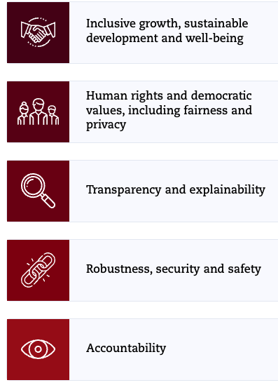
OECD AI Principles
Source: https://oecd.ai/en/ai-principles
Notes:
Organisation for Economic Co-operation and Development

Slide 9


Responsible AI in Military Domain (REAIM)
REAIM is a platform for global discussion with all stakeholders on ways to ensure responsible military application of AI.
Released Blueprint for Action in Sep 2024, endorsed by 61 countries including USA, UK, Sweden, South Korea, Japan and Singapore.
Blueprint for Action
Ethical Compliance
Human Oversight
Bias Mitigation
Transparency
Robustness
Source: https://www.reaim2024.kr/

Slide 10
Key Responsible AI Principle - Fairness
AI systems should treat everyone equally and provide the same recommendations to all individuals.
Fairness in AI systems prevents discrimination based on personal characteristics.
Important to prevent perpetuating or amplifying biases.
AI models are trained on datasets, often scraped from the Internet, and these data often reflect our our own established human bias
Ensuring fairness requires diverse training data, rigorous bias testing, and ongoing performance monitoring across different subpopulations.

Slide 11
Key Responsible AI Principle - Transparency
As AI systems grow complex, mechanisms must be in place to understand and evaluate their outputs.
There needs to have clear explanations of AI decisions and the ability for users to question those decisions.
Transparency is an enabler of trust in the AI systems that we’re producing and operating, and trust in turn can foster faster adoption of those capabilities

Slide 12
Key Responsible AI Principle - Robustness & Veracity
Robustness and veracity ensure AI systems produce reliable outputs, even with unexpected inputs.
Techniques like adversarial training, input validation, and anomaly detection enhance AI robustness.
Verify the accuracy of training data and model outputs.
  Tests can be designed to check outputs against facts (e.g., Amazon Science's RefChecker Framework allows fact-checking of an LLM’s output)

Slide 13
Key Responsible AI Principle - Accountability
Organisations and individuals developing, deploying or operating AI systems should be held accountable for their proper functioning
AI developers should ensure traceability, including in relation to datasets, processes and decisions made during the AI system lifecycle, to enable analysis of the AI system’s outputs and responses to inquiry
AI actors should apply a systematic risk management approach to each phase of the AI system lifecycle on an ongoing basis and adopt responsible business conduct to address risks related to AI

Slide 14
Key Responsible AI Principle - Privacy
AI systems should respect privacy and maintain security by protecting private and confidential information.
They should also resist attacks and attempts to corrupt or compromise the system.
Mechanism should be developed for individuals to control how their data is collected and used.

Slide 15
Building Trustworthy AI
Foster collaboration across all disciplines, engaging experts from policy, technology, ethics and social advocacy to ensure multifaceted perspectives
Prioritize ongoing education on AI best practices at all levels to maintain awareness and adaptability
Implement AI ethics throughout the technology’s design, building them into AI solutions from the ground up

Slide 16
Building Trustworthy AI
Establish clear oversight mechanisms, such as ethics committees or review Boards, to monitor compliance and guide ethical decision making
Protect end-user privacy and sensitive data through strong AI governance and data usage policies
Encourage transparency in AI processes, enabling accountability and trust from stakeholders and the public
Design for humans by using a diverse set of users and use-case scenarios and incorporating this feedback before and throughout the project’s development.

Slide 17
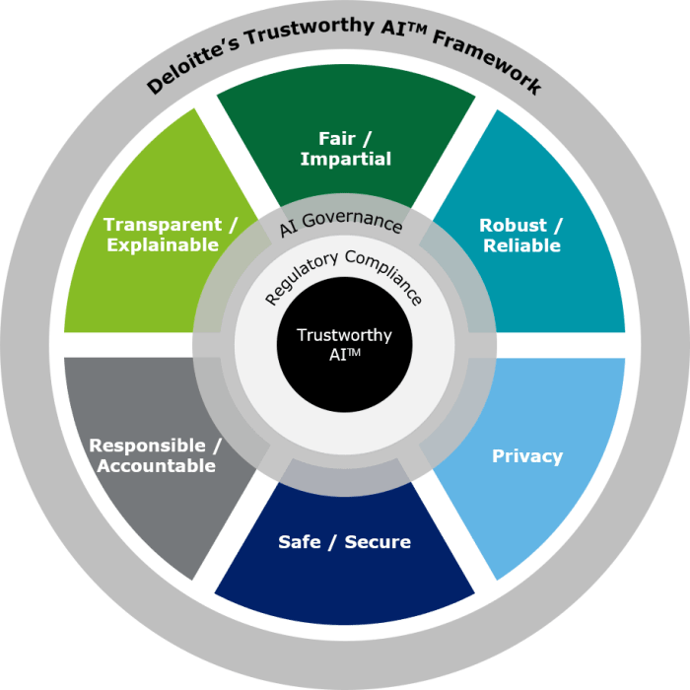
Trustworthy AI Framework
Notes:
Need AI governance to ensure trustworthy AI

Slide 18

Model AI Governance Framework

Slide 19
Why we need AI governance framework? AI Governance?
AI governance puts in place the rules, policies, processes, and procedures to realize responsible AI principles

Slide 20
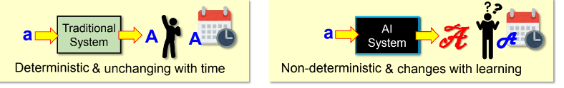
Do we need another Governance Framework for AI?
Most organisations already have processes and systems in place for governance, planning, budgeting, risk management and technology audit.
But there are two key differences between conventional IT and AI-based systems.
  AI models are non-deterministic and its operation is often opaque
  AI models learns from data and evolves over time.
Organisations should pay equal attention to the model code and training dataset.
Governance issues like “how was it trained?” & continuous monitoring are important.

Slide 21
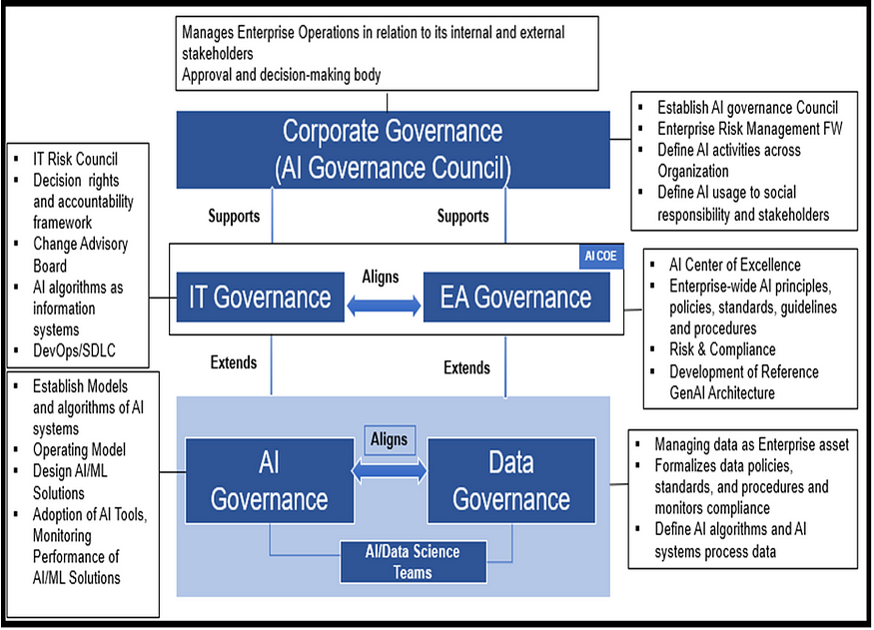
Where AI governance fits?
Notes:
An organization may already have different governance systems, AI governance needs to align and incorporated into existing governacen structure.
EA governance – enterprise architecture
AI governance can be an extension of existing IT governance and should seek to align with any existing data governance.
https://medium.com/@gopalakrishnabehara/published-in-a-z-magazine-d5a39aeac069

Slide 22
Singapore Model AI Governance Framework
In 2019, Singapore launched our Model AI Governance Framework (“Model Framework”) at the World Economic Forum in Davos,
Model AI governance Framework refreshed in 2020
Model AI governance Framework for Generative AI released in 2024
The Governance framework aims to translate ethical principles into practical recommendations that organisations could readily adopt to deploy AI responsibly.

Slide 23

Guiding Principles
The Model Framework is based on two high-level guiding principles that promote trust in AI and understanding of the use of AI technologies
Helps to build trust and confidence in AI.
Helps to amplify human capabilities, protection of the interests of human beings, including their well-being and safety

Slide 24
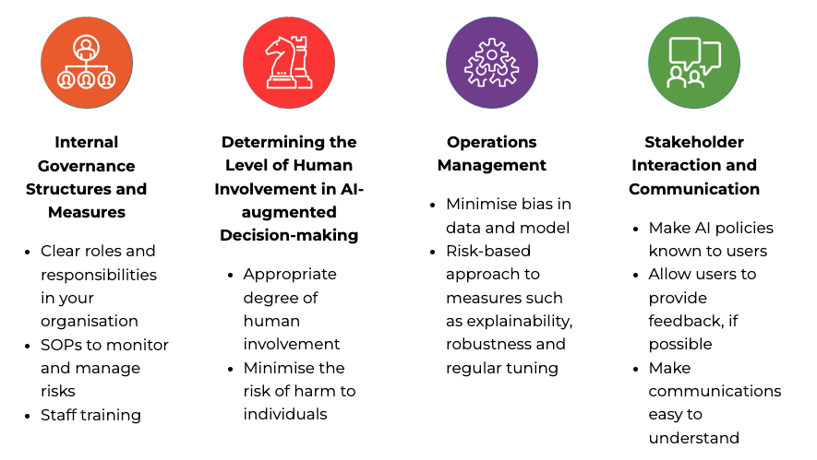
4 Key Areas
Guidance on measures promoting the responsible use of AI that organisations should adopt in the following key areas:

Slide 25
Internal Governance Structures
Internal governance structures allows organisations to have appropriate oversight over how AI technologies are brought into their operations and/or products and services.
Existing governance structures can be adapted to incorporate values, risks, and responsibilities relating to algorithmic decision-making.
  E.g., risks associated with the use of AI can be managed within the enterprise risk management structure, ethical concerns of AI can be managed through existing Institutional Review Boards

Slide 26

Case Study - Master Card
A Governance Council is established to review and approve implementations of AI applications that are determined to be high risk
  Members include Executive VP of AI Centre of Excellence, Chief Data Officer, Chief Privacy Officer, Chief Information Security Officer, Data Scientists, and Reps from business teams
Risk management
  Conduct initial risk scoring, high risk project will be referred to governance council
  Identify potential mitigants as part of the risk management review

Slide 27
Case Study – Master Card
  Defined Clear Roles & Responsibilities
Chief Data Officer & Chief Privacy Officer
Review AI implementation to ensure:
Data is fit for purpose of AI
AI used for ethical purpose
Impact to individual is appropriate and potential harm is sufficiently mitigated
Chief Information Security Officer
Ensure security by design is implemented
Data Science Teams
- Build and implement AI
- continual information sharing with CDO & CPO regarding the required governance

Slide 28
Case Study Exercise
Has your company already established an internal governance structure?
What are the different roles & responsibilities?

Slide 29
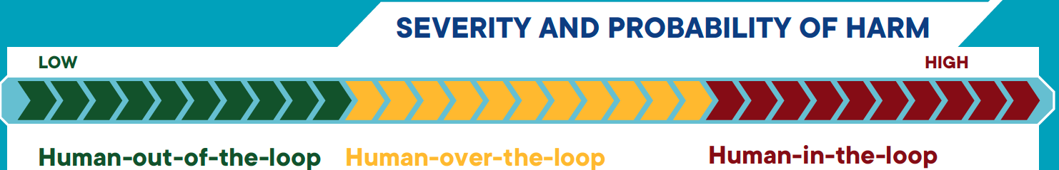
Human Involvement in AI-augmented Decision Making
Degrees of human oversight
  Human-in-the-loop
  Human-out-the-loop
  Human-over-the-loop
Risk impact assessment should be carried out to determine the level of human oversight.

Slide 30


Human-in-the-Loop
Human oversight is active and involved, with the human retaining full control and the AI only providing recommendations or input.
Decisions cannot be exercised without affirmative actions by the human, such as a human command to proceed with a given decision.
Recommendation of actions, context and evidence
Make Decision
Data
Outcome

Slide 31
Human-out-of-the-loop
There is no human oversight over the execution of decisions.
The AI system has full control without the option of human override.
Data
Make decision
Outcome

Slide 32
Human-over-the-loop
Human is in a monitoring or supervisory role, with the ability to take over control when the AI model encounters unexpected or undesirable events (such as model failure)
Data
Make decision
Outcome
Exception
Review outcome, make decision
Notes:
Example:
GPS navigation system plans the route from Point A to Point B, offering several possible routes for the driver to pick. The driver can alter parameters (e.g. due to unforeseen road congestions) during the trip without having to re-programme the route.

Slide 33
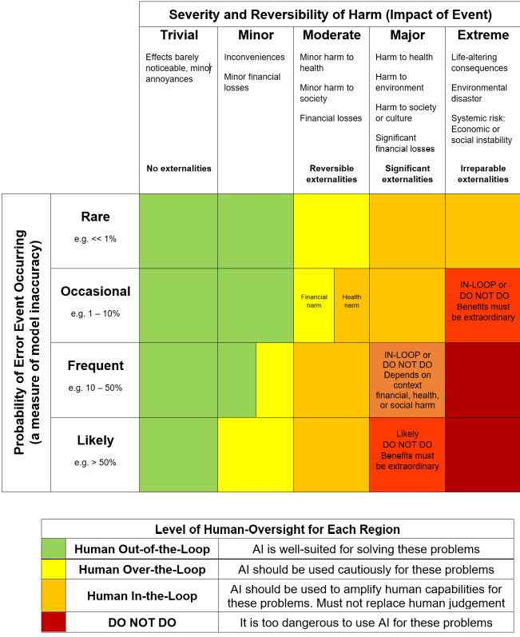
Probability-Severity of Harm Matrix

Slide 34

Case study
An online retail store wishes to use AI to fully automate the recommendations of products to individuals based on their browsing behaviours and purchase history.
Human-out-of-the-loop
Human-in-the-loop?
Human-over-the-loop
Notes:
Use mentimeter for this exercise

Slide 35

Case Study
Singapore Eye Lesion Analyser (SELENA+) is a deep-learning AI software system that can detect potential threatening eye conditions accurately and efficiently.
It can detect abnormal fundus images, and in particular, signs of diabetic retinopathy disease.
Human-out-of-the-loop
Human-in-the-loop?
Human-over-the-loop

Slide 36

Case Study
Suade Labs provides an AI-enabled solution that allows financial institutions to process large volumes of granular data and generate the required regulatory data, calculations, and reports with the necessary controls and governance.
Human-out-of-the-loop
Human-in-the-loop?
Human-over-the-loop

Slide 37

Case Study
Google map helps user to navigate the routes from Point A to Point B.
Human-out-of-the-loop
Human-in-the-loop?
Human-over-the-loop

Slide 38
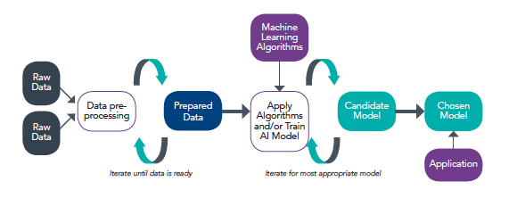
Operations Management
Model development process
Data
Model
Notes:
Basically modern AI is DATA + MODEL

Slide 39
Ensure Good Data Accountability Practices
Understand Lineage of Data
to ascertain the quality of the data based on its origin and subsequent transformation
Ensure Data Quality
Accuracy
Minimising inherent bias
Selection bias
Measurement bias
Completeness
Veracity of data
Relevance
Integrity
Trace potential sources of errors
Notes:
Selection bias
This bias occurs when the data used to produce the model are not fully representative of the actual data or environment that the model may receive or function in.
Common examples of selection bias in datasets are omission bias and stereotype bias.
Omission bias describes the omission of certain characteristics from the dataset. For example, a dataset consisting only of Asian faces will exhibit omission bias if it is used for facial recognition training for a population that includes non-Asians.
A dataset of vehicle types within the central business district on a weekday may exhibit stereotype bias weighted in favour of cars, buses and motorcycles but under-represent bicycles if it is used to model the types of transportation available in Singapore.
Measurement bias
This bias occurs when the data collection device causes the data to be systematically skewed in a particular direction. For example, the training data could be obtained using a camera with a colour filter that has been turned
off, thereby skewing the machine learning result.

Slide 40
Model & Algorithms
The choice of the algorithms for the model you build needs to consider various aspects such as explainability, repeatability, robustness, regular tuning, reproducibility, traceability, and auditability
  Contributes towards building a Trustworthy AI system
  Consider what is the most essential aspects for your business or stakeholders

Slide 41
Biasness/Fairness
Identify any bias in the dataset and models that emerged during testing
  Remove protected or discriminatory features. Such as gender and ethnicity should not be fed into the model if it irrelevant for solving the underlying problem
  Features that seem not harmful or offensive may turn out to be highly correlated, biased or discriminatory. Gender, ethnicity and socioeconomic status can often be inferred from names, addresses and location data
  Bias can result from an incomplete representation of a minority class. Increase diversity in data. Inclusion of view from stakeholder that are affected.
  Sometimes a metric may not be an accurate or well-generalised proxy for the underlying problem
Notes:
We had seen from the AI project lifecycle, the potential ethical issues may be present in the development or the final deployment model.
So it is important that we identify any bias in the dataset and models that emerged during testing.
-Remove protected or discriminatory features. Such as gender and ethnicity should not be fed into the model if it irrelevant for solving the underlying problem
-Features that seem not harmful or offensive may turn out to be highly correlated, biased or discriminatory. For example Gender, ethnicity and socioeconomic status can often be inferred from names, addresses and location data
-Bias can result from an incomplete representation of a minority class. Increase diversity in data. We can collect more data for the similar content. Example when develop the face recognition system, we to ensure the data contain different
races or different citizen from different countries
Inclusion of view from stakeholder that are affected.
-Sometimes a metric may not be an accurate or well-generalised proxy for the underlying problem.
When testing of the model always try different metric to check for the different to detect the underline ethicial problem.
Example the classification problem in machine learning, we are interested to understand the overall perform we use the accuracy metric.
If we want to know how each label is performed, we may use the recall metric, this reflect the perform of individual label that is not influence by the other.
So it important that we have some AI ethic and governance in place, during the develop and deployment we will test the data and model to prevent it from it to happen.

Slide 42
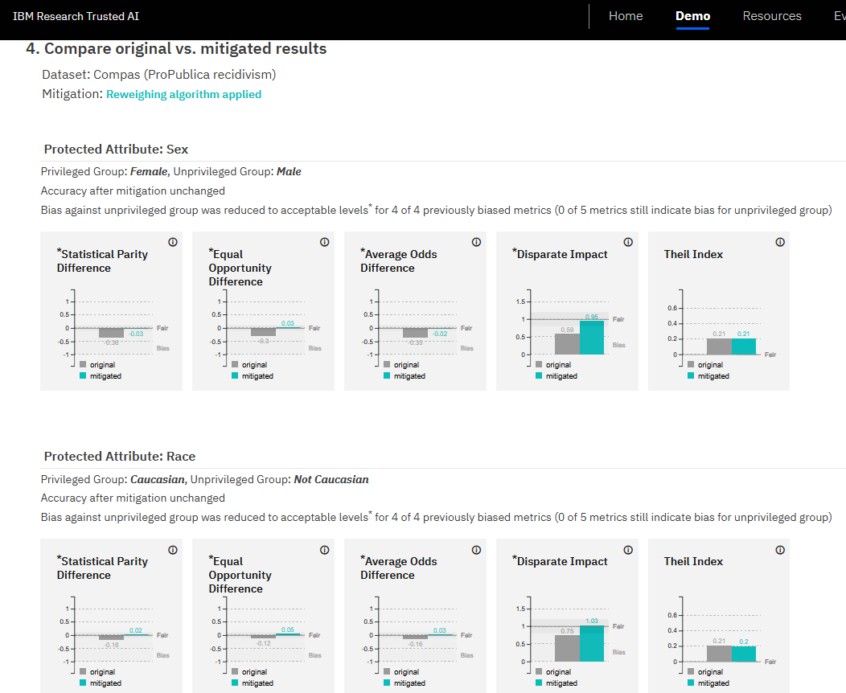
Biasness/Fairness
https://aif360.res.ibm.com/

Slide 43
Data Privacy
The PDPA recognises both the need to protect individuals’ personal data and the need of organisations to collect, use or disclose personal data for legitimate and reasonable purposes.
  Consent Obligation
  Purpose Limitation Obligation
  Protection Obligation
  Retention Limitation Obligation
  Transfer Limitation Obligation
  Accuracy Obligation
https://www.pdpc.gov.sg/Overview-of-PDPA/The-Legislation/Personal-Data-Protection-Act/Data-Protection-Obligations
Notes:
https://www.pdpc.gov.sg/Overview-of-PDPA/The-Legislation/Personal-Data-Protection-Act/Data-Protection-Obligations
The PDPA recognises both the need to protect individuals’ personal data and the need of organisations to collect, use or disclose personal data for legitimate and reasonable purposes.
This regulation dictate some obligation when using such private date. The whole list of the obligations are stated in the link given.
We will discuss those that are more relevant o the AI project lifecycle.
Consent Obligation
Only collect, use or disclose personal data for purposes which an individual has given his/her consent to.
Purpose Limitation Obligation
The main objective of the Purpose Limitation Obligation is to ensure that organisations collect, use and disclose personal data that are relevant for the purposes, and only for purposes that are reasonable.
Protection Obligation
Reasonable security arrangements have to be made to protect the personal data in your organisation’s possession to prevent unauthorised access, collection, use, disclosure or similar risks.
Retention Limitation Obligation
Cease retention of personal data or dispose of it in a proper manner when it is no longer needed for any business or legal purpose.
Transfer Limitation Obligation
Transfer personal data to another country only according to the requirements prescribed under the regulations, to ensure that the standard of protection is comparable to the protection under the PDPA
Accuracy Obligation
Make reasonable effort to ensure that the personal data collected is accurate and complete, especially if it is likely to be used to make a decision that affects the individual or to be disclosed to another organisation.

Slide 44
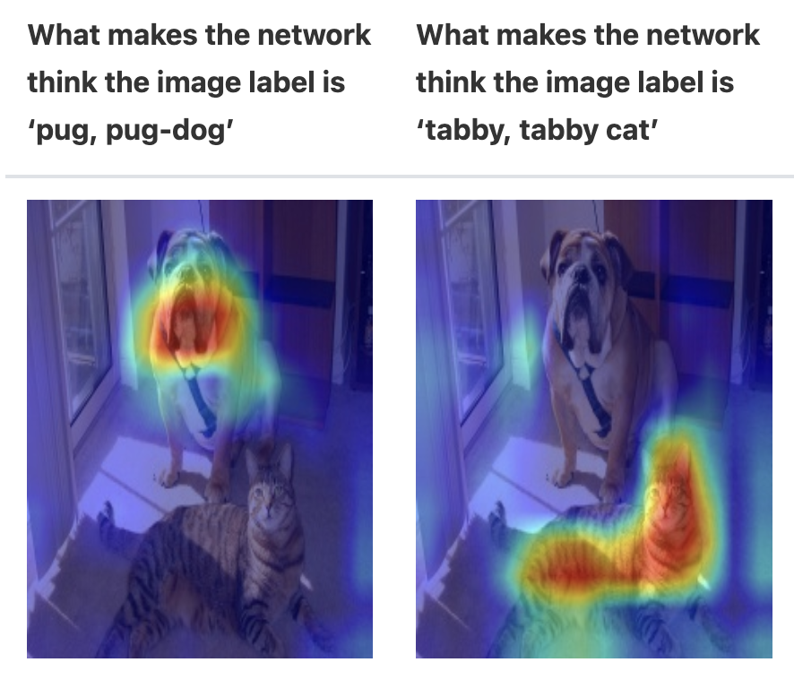
Explainability
Explainability is achieved by explaining how deployed AI model’s algorithm functions and/or how the decision-making process incorporates model predictions.
Some practices:
  Document model training and selection process
  Document why certain features are selected over others for training
  For ‘black box’ model, some supplementary explanation tool can be help to visualize what the model is focusing when making a prediction or decision

Slide 45
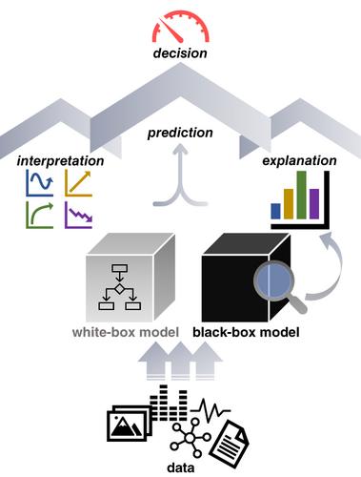
Explainability vs Interpretability
Explainable AI describes why the AI model made a prediction.
Interpretable AI describes how it makes the prediction.
Example: an AI model used to improve employee health and productivity. The health of employees may depend on factors including their age, demographics, department and business function, past health conditions, and additional factors.
A fully explainable AI system will help the HR to discover the exact cause-and-effect of their decision controls on the corresponding employee health attributes.
A fully interpretable model will help them discover the inner logic of this cause-and-effect.

Slide 46
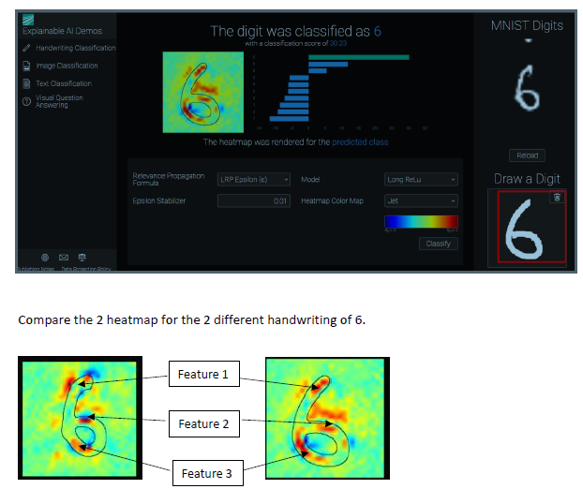
Explainability
Http://www.heatmapping.org/

Slide 47
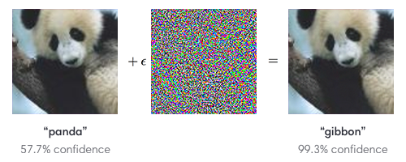

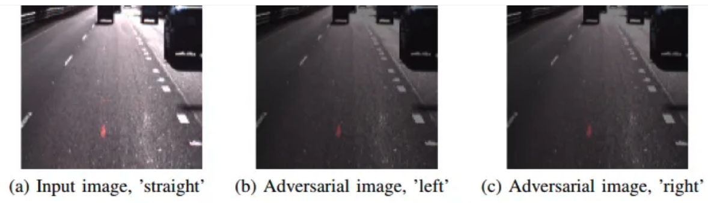
Testing for Robustness of Model
Model can produce unexpected results even with minor (even not perceptible to human) modifications to input
Physical Adversarial Attacks
Notes:
Adversarial testing is resource intensive so consider risk-based approach

Slide 48
Testing for Robustness of Model
Consider adversarial testing (red teaming) on model to ensure that it can handle a broader range of unexpected input variables
Consider risk-based approach to decide what AI-powered features requires adversarial testing
  Adversarial testing is a resource-intensive exercise
Notes:
Adversarial testing is resource intensive so consider risk-based approach

Slide 49
Regular tuning
Establish an internal policy and process to perform regular model tuning
  Changes to customer behaviour over time.
  Changes in commercial objectives, risks, or corporate values

Slide 50
Stakeholder Communication
A good communication with the stakeholders is essential in building trust in the AI system
Information Need
Audience
Context
Purpose

Slide 51
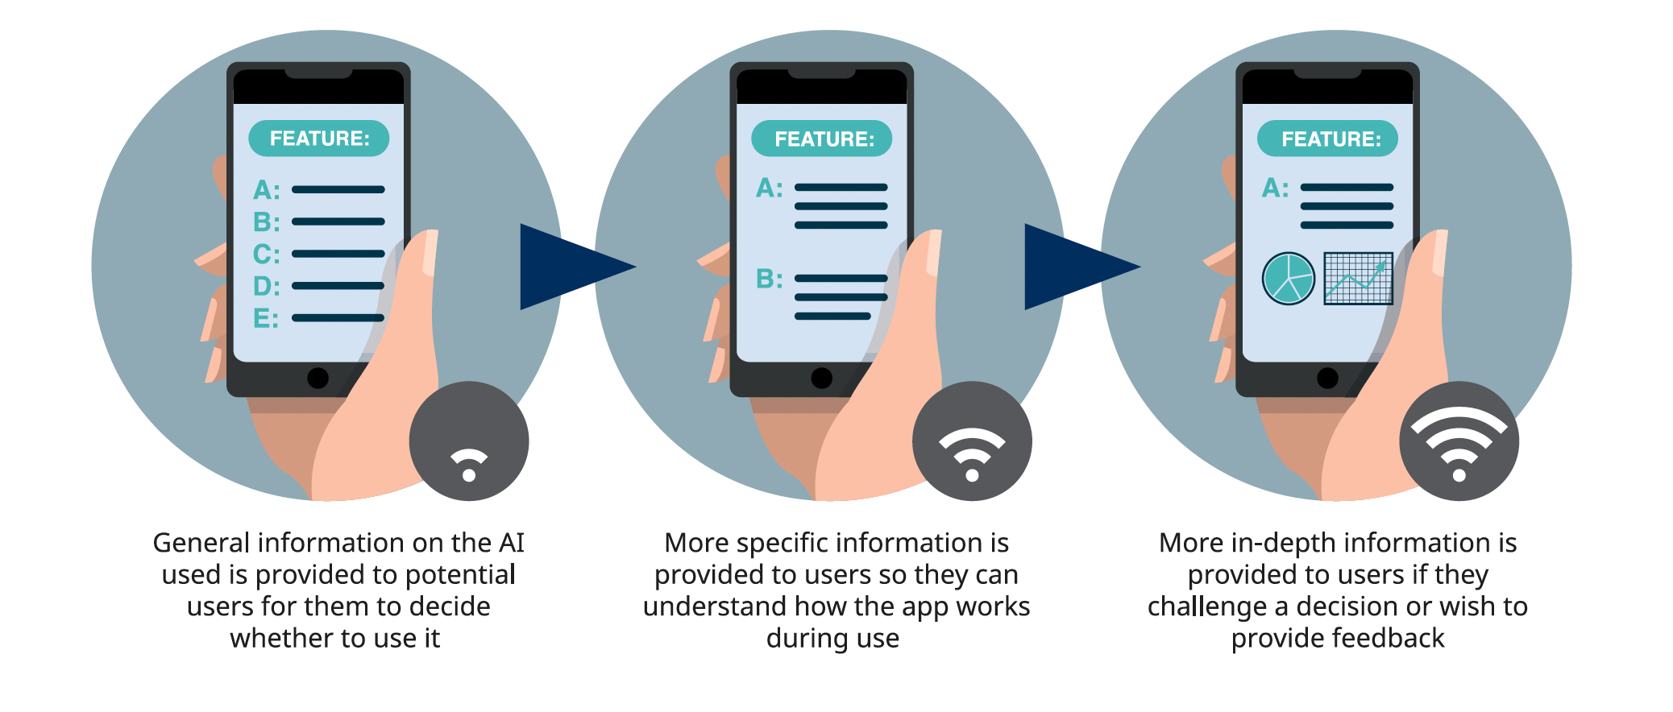
Stakeholder communication
General Disclosure
  Provide info on whether AI is used in the product or service
  Info such as how AI is used in decision-making, what are the benefits, what steps are taken to mitigate risks, how it can affect the end-user, will be helpful to instil confidence and trust

Slide 52
Stakeholder communication
Option to opt-out
  Depends on the degree of risk/harm to individuals, reversibility of AI decision, cost of alternate way of decision making, technical feasibility, complexity of maintaining two parallel system
Communication channels
  Feedback channels
    Raise feedback or queries, e.g. if inaccuracies spotted by user
  Decision review channels
    For user to raise request to review material AI decision

Slide 53
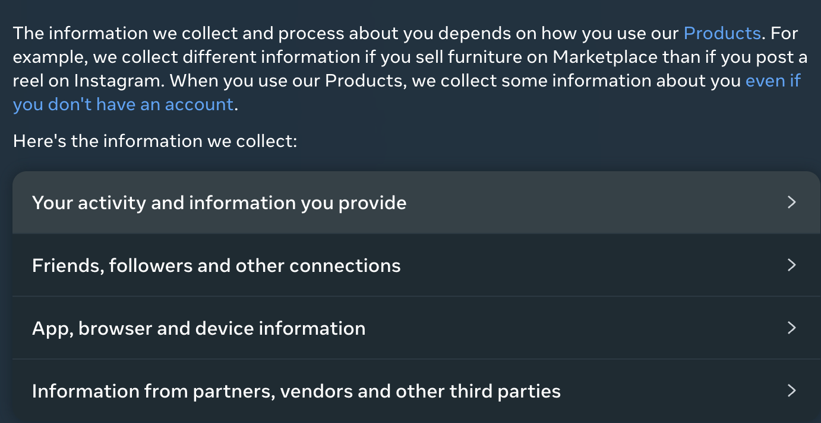
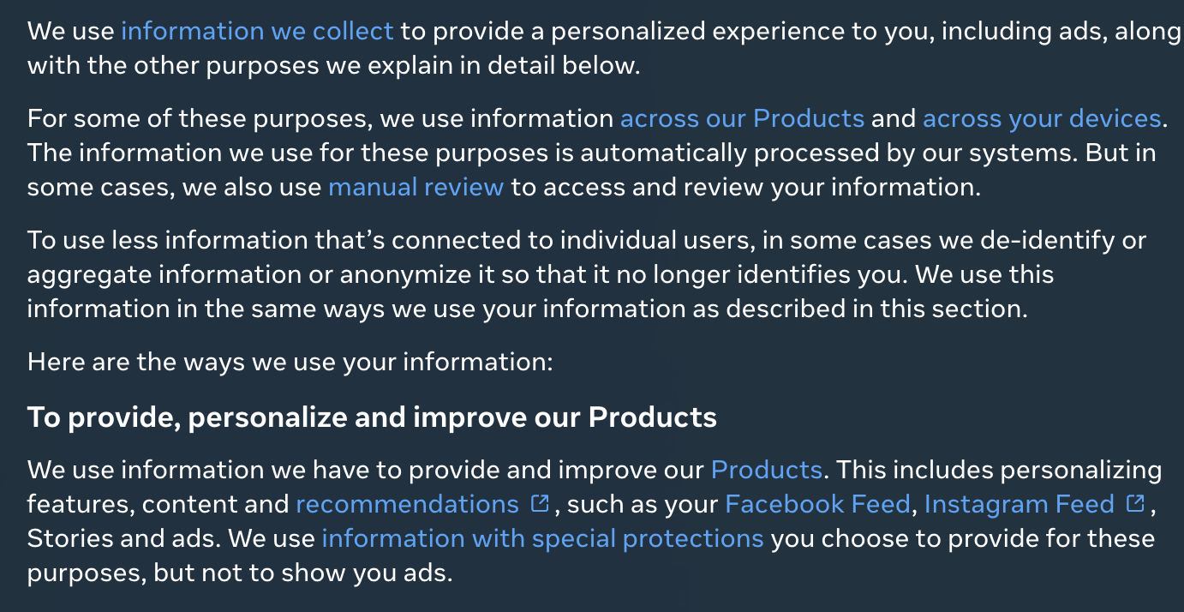
Case study - Facebook
Disclosure on information collected
Disclosure on information use

Slide 54
Sector-specific Regulations and Guidelines
Monetary Authority of Singapore published the Principles to Promote Fairness, Ethics, Accountability and Transparency in the Use of Artificial Intelligence and Data Analytics in Singapore’s Financial Sector (the “FEAT Principles”)

Slide 55
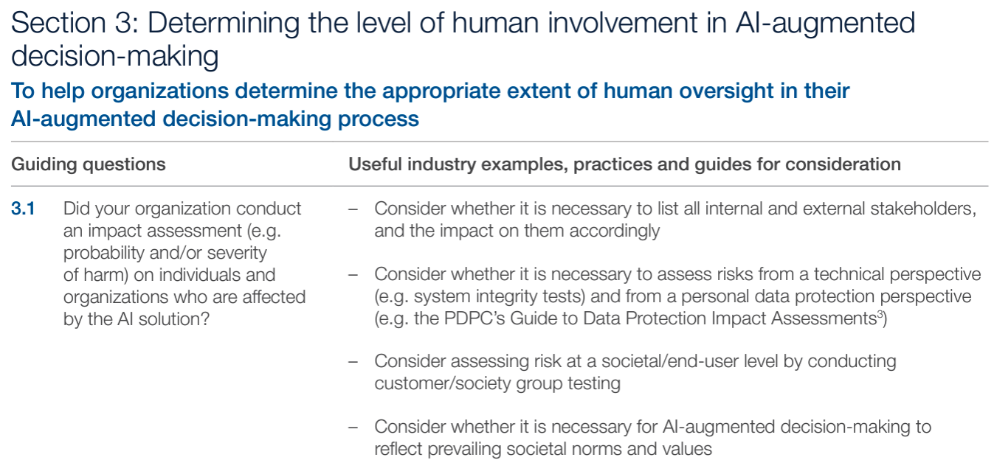
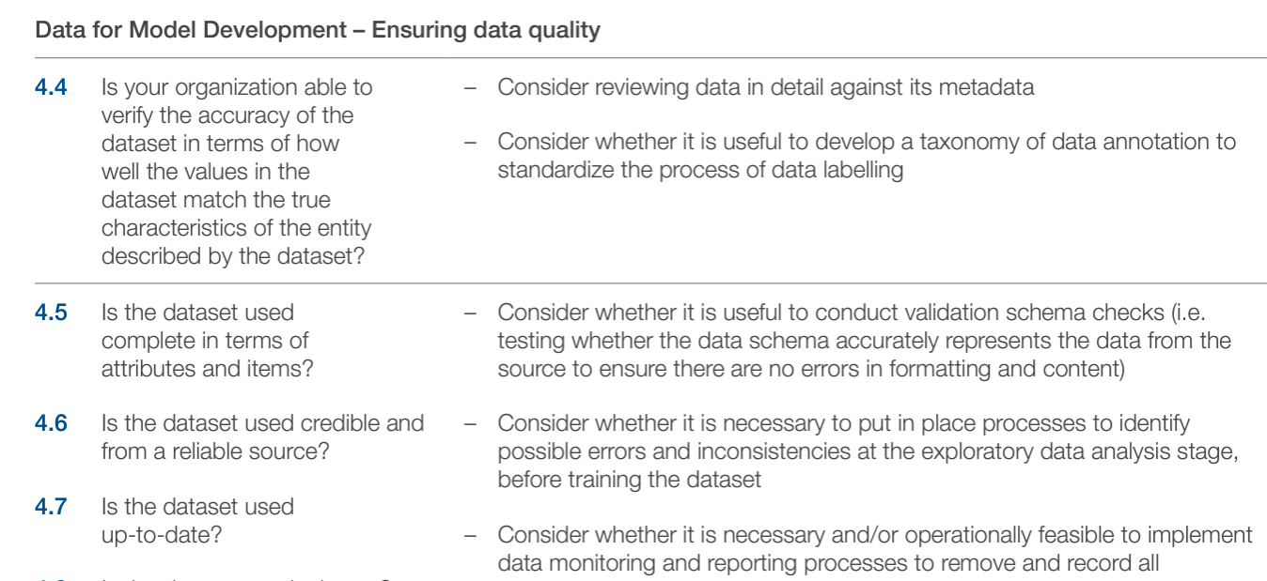
Implementation and Self-Assessment Guide for Organizations (ISAGO)
provides a set of questions and practical examples to enable organizations to assess the alignment of their AI governance practices with the Model Framework

Slide 56
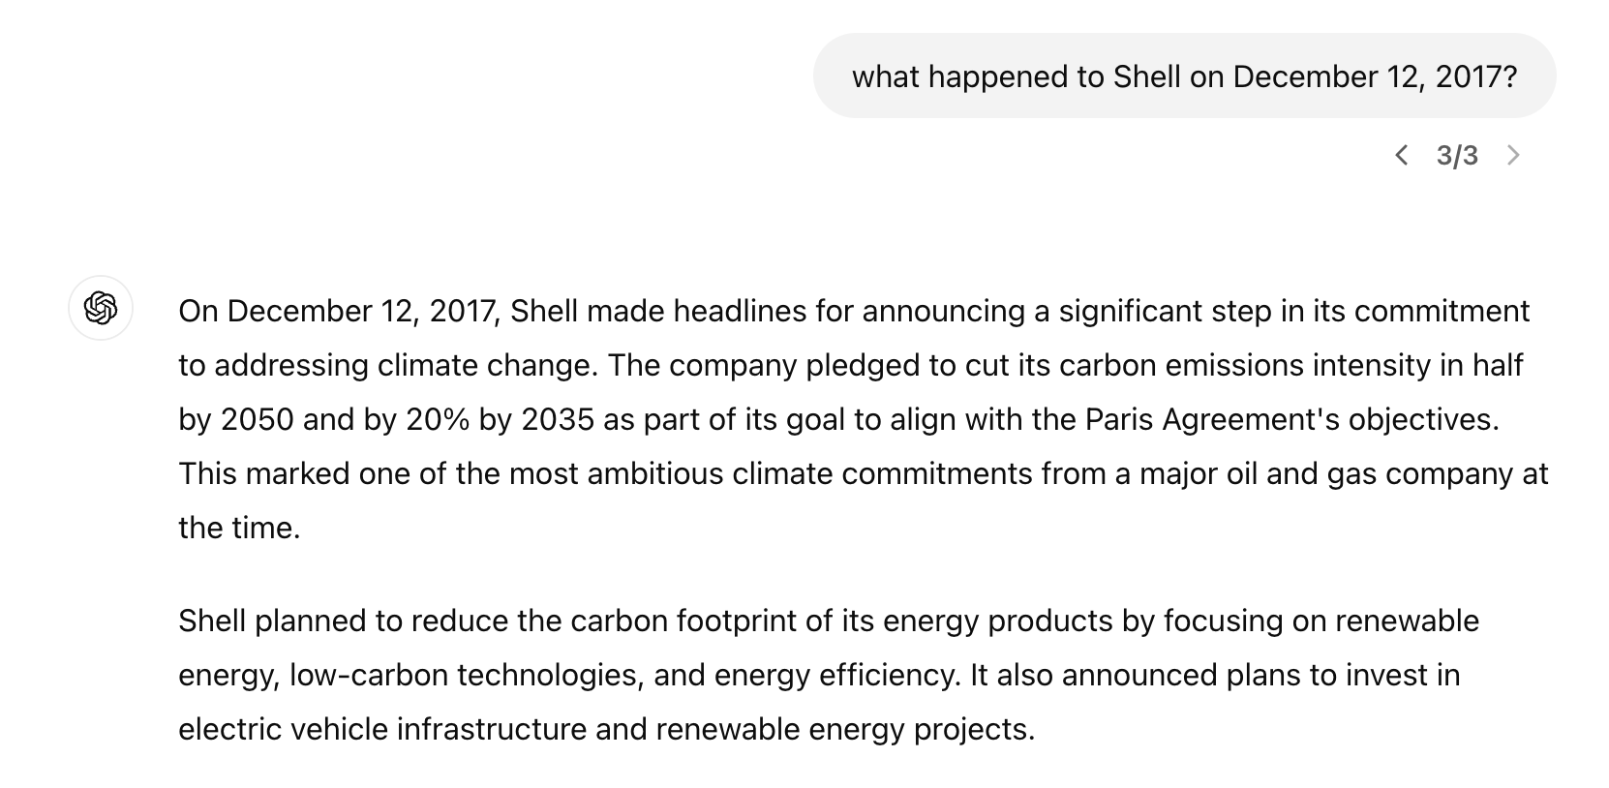
New Risks with Generative AI
Mistakes And “Hallucinations”

Slide 57
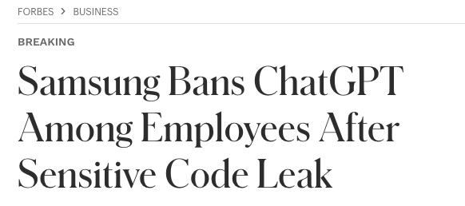
New Risks with Generative AI
Privacy And Confidentiality
Generative AI tends to have a property of “memorisation”, posing risks to privacy
  Adversaries may find out if a certain individual is part of a training set by querying the trained model or even reconstruct training data by querying the model.
Memorisation property also poses copyright and confidentiality issues for enterprises and companies

Slide 58

New Risks with Generative AI
Scaling Disinformation, Toxicity And Cyber-threats
Dissemination of false content such as fake news is becoming increasingly hard to identify due to convincing but misleading text, images and videos, potentially generated at scale by generative AI.

Slide 59

New Risks with Generative AI
An Era of Copyright Challenges
  Concerns of copyrighted materials used for training the generative model such as GPT and Stable Diffusion
  Rising concern in the creative community regarding AI that explicitly creates the style and expression of authors, artists or musicians.

Slide 60

New Risks with Generative AI
Embedded Biases Which Echo In Downstream Applications
Foundation models capture the inherent biases present in the training dataset (e.g. corpus of the web).
Especially problematic as these biases spread to downstream models trained from them, as well as the applications developed based on them

Slide 61
New Risks with Generative AI
Values, Alignment, And The Difficulty Of Good Instructions
An objective function for AI assistants needs to prioritise between the assistant being “helpful” or “harmless”.
However, it is difficult to define and specify what these concepts are, and how to trade-off between them
  Insistence on avoiding harm can lead to “safe” responses that might not be valuable to the user.
Helpful
Harmless

Slide 62
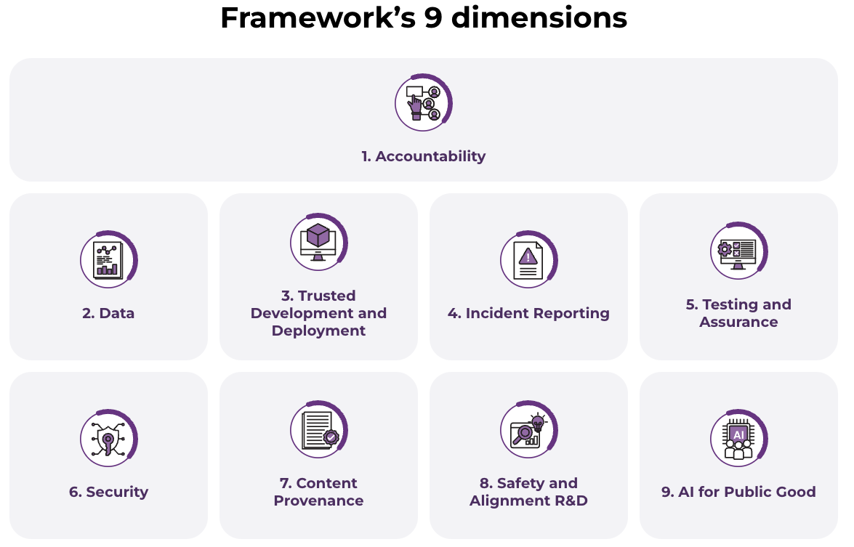
Model Framework for Generative AI (2024)

Slide 63
Key Dimensions of a Trusted AI Ecosystem
Accountability
  Shared responsibility across the AI development chain
  Practical steps to allocate accountability
Data
  Data quality and ethical sourcing
  Clear guidelines for using personal data and copyrighted material
Trusted Development and Deployment
  Transparency around safety and hygiene measures
  Industry adoption of best practices and disclosure

Slide 64
Key Dimensions of a Trusted AI Ecosystem
Incident Reporting
  Establishing structures for monitoring and reporting incidents
  Continuous improvement of AI systems
Testing and Assurance
  Third-party testing and assurance
  Development of common standards for AI testing
Security
  Addressing new security risks posed by generative AI
  Adapting existing information security frameworks

Slide 65
Key Dimensions of a Trusted AI Ecosystem
Content Provenance
  Transparency about content origin
  Leveraging technologies like digital watermarking and cryptographic provenance
Safety and Alignment R&D
  Accelerated investment in R&D to improve model safety and alignment
  Global cooperation among AI safety R&D institutes
AI for Public Good
  Democratising AI access
  Improving public sector AI adoption
  Upskilling workers and developing AI sustainably

Slide 66
Key Dimensions of a Trusted AI Ecosystem
A trusted AI ecosystem requires a collective effort from policymakers, industry, researchers, and the public.
By addressing these key dimensions, we can harness the potential of generative AI while mitigating its risks.
Continuous adaptation and innovation are essential to keep pace with the rapidly evolving AI landscape.

Slide 67
Case Study – Use of AI in Israel’s war on Gaza
In the past wars, Israeli defined ”human targets” to kill as senior military commanders after carefully marked them so. However, after 7th Oct 2023 attack (where Hamas Hamas-led militants launched a deadly assault on southern Israeli communities), the army decided to designate all operatives of Hamas’ military wing as human targets, regardless of ranks.
In previous wars, to authorize assassination of single human target, an officer had to go through a complex and lengthy cross-checking of evidence that the person was indeed a senior member of Hamas’ military wing. However, once the list was expanded to include tens of thousands of lower-ranking operatives, the Israeli army figured it had to rely on artificial intelligence – Lavender.
Lavender learns to identify characteristics of known Hamas operatives, whose information was fed to the machine as training data, and then to locate these same characteristics — also called “features” — among the general population.
After manually checking that the AI system achieve 90% accuracy with a random test sample targets, sweeping order was given to treat Lavender decision as order, with no independent verification of the choice and examination of the raw intelligence data on which the decision is based on.
Notes:
The Gospel
https://www.972mag.com/mass-assassination-factory-israel-calculated-bombing-gaza/
Lavendar
https://www.972mag.com/lavender-ai-israeli-army-gaza/
Opinion piece
https://www.rsis.edu.sg/rsis-publication/idss/ip24063-the-case-for-ai-based-decision-support-systems-oversight/

Slide 68
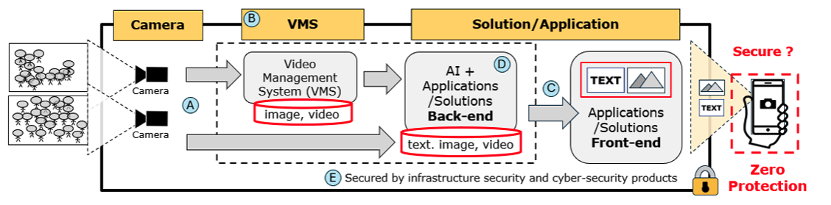
Case Study Discussion – Video surveillance
CCTV systems are deployed across a variety of settings, from healthcare facilities and retail spaces to banks and public transportation, to protect the safety and security of people within these premises. These surveillance systems are monitored by surveillance officers who work in shifts, following pre-defined protocols to respond to incidents.
Discuss some design consideration of such as system in the context of Responsible AI principles.
Notes:
ensures the integration of privacy and data protection principles from the system's inception,
Key practices:
Data Minimization: The system should collect only the data that is essential for its purpose, demonstrated by the selective capture of images and video by the camera subsystem.
Secure Data Handling: The VMS (video management system) must secure images and videos against unauthorized access, maintaining integrity during transmission to AI applications and back-end solutions
Transparency and Accountability: There must be clarity in the flow of data, including text, images, and videos, from the backend to the front-end solutions, with explicit policies on data processing purposes.
PETs: Privacy-enhancing technologies use techniques like dynamic privacy masking. These are crucial in AI apps to obscure personal identifiers in video data, ensuring privacy preservation.
End-to-End Security: A robust design should prevent external and insider threats, signified by secure infrastructure and cybersecurity solutions that protect against unauthorized access.

Slide 69
Case Study Discussion – Fraud Detection
To improve the operational efficiency and effectiveness of its current anti money laundering surveillance, DBS developed an AI model - the Anti-Money Laundering (AML) Filter Model.
The AML Filter Model identifies predictive indicators of suspicious transactions to reduce the number of false positives generated by the non-AI system, thereby reducing the number of alerts that require manual review.
Suggest some of the possible risks and how relevant AI governance practices can be implemented by the bank to address the risks
Notes:
Internal Structure:
Have a overall committee to oversee the ai development (the RDU) – important to include senior leaders from different organization units (e.g. legal, human resource, banking, etc) that represent diverse views
What kind of things to review: complied with legal, security and data quality
A comimittet can be formed to review the EDA, evaluation training, review data collection process
Data maybe biased, bank can
Should it disclose how the

Slide 70


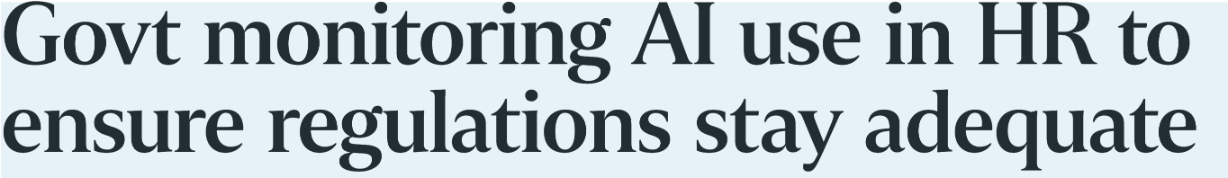
Case Study Discussion - AI-assisted HR tools
AI use in HR tools for hiring or promotion decision
Applying the responsible AI principles, what are the steps you can take to mitigate the risks?

Slide 71


Case Study Discussion – Smart Retail Shop
In the unmanned stores, customers can walk in, grab the items they need and walk out without having to whip out their phone, credit card or cash to make payment.
Before entering, they will have to scan their FPG app’s Pay/Earn QR code, or tap their debit or credit card, at the store gantry.
An advanced artificial intelligence (AI) system in the outlet tracks customers’ actions, while items removed from shelves are recorded automatically.
The customers’ virtual baskets are updated accordingly, and their digital accounts are automatically and securely charged within 10 seconds of them exiting the store.
Discuss some AI governance practices that can be applied here.

